Slide 1
Entrepreneurial green cities
Ulrich Mans
PhD Candidate
Investigating the advance of renewable energy in emerging market cities

Slide 2
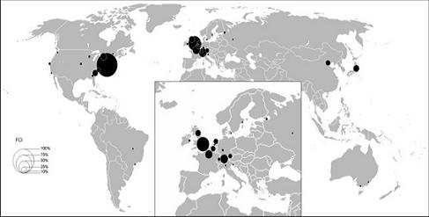
Step 1: Global city networks Looking beyond rankings: every city is global in its own ways

Slide 3
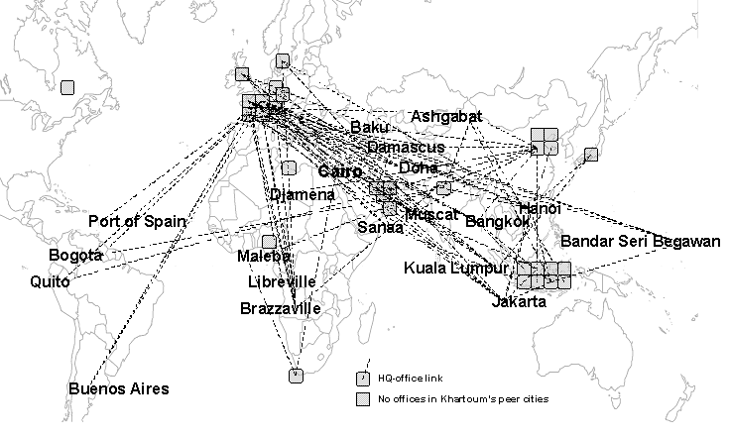
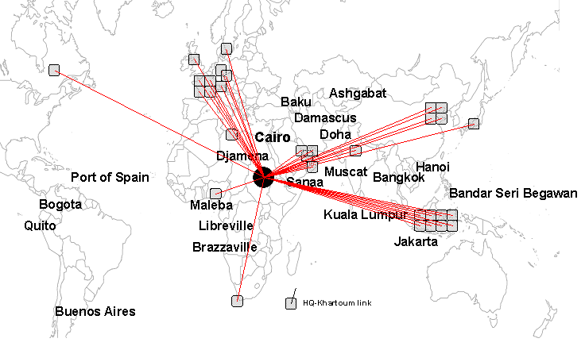
Step 1: Global city networks Looking beyond rankings: every city is global in its own ways

Slide 4
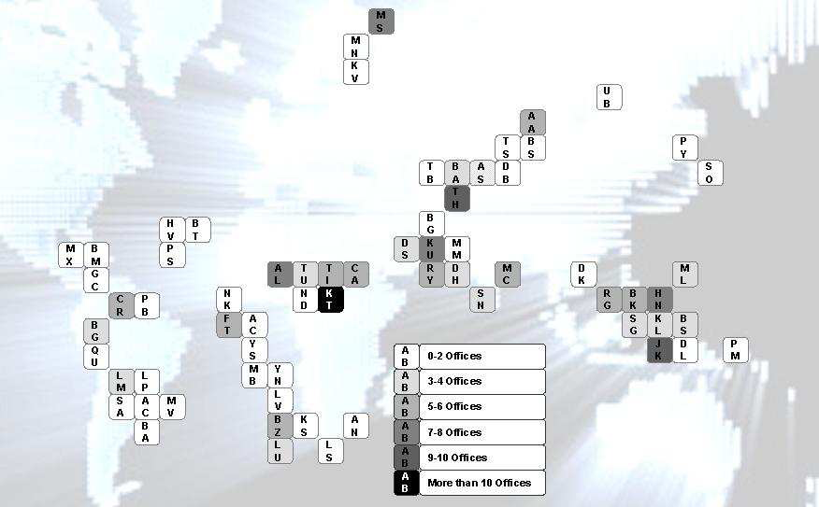
Step 1: Global city networks Looking beyond rankings: every city is global in its own ways

Slide 5
Step 1: Global city networks Looking beyond rankings: every city is global in its own ways
Towards a new field of research:
Industrialised markets… to… emerging markets
From mega-cities … to… medium size cities
Economic footprint … to… sector-specific leverage
A new type of city connectivity, based on a city’s ‘prime sectors’

Slide 6
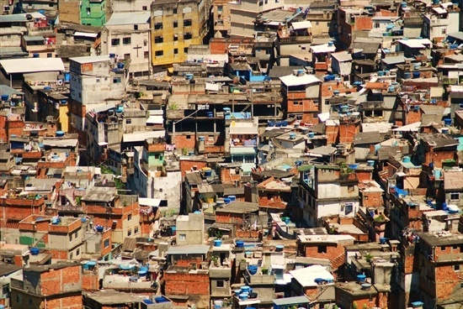
Looking at medium-size cities Why the 1-5 million category is important: the bad news
Most people live there (23%)
Growing in numbers (361 in 2005, 524 in 2025)
Fast-paced economic growth

Slide 7
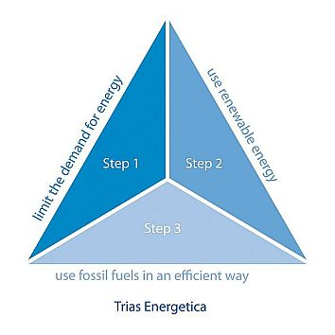
Step 2: Renewable Energy Looking beyond saving energy: new energy production

Slide 8
Step 2: Renewable Energy Looking beyond saving energy: new energy production

Slide 9
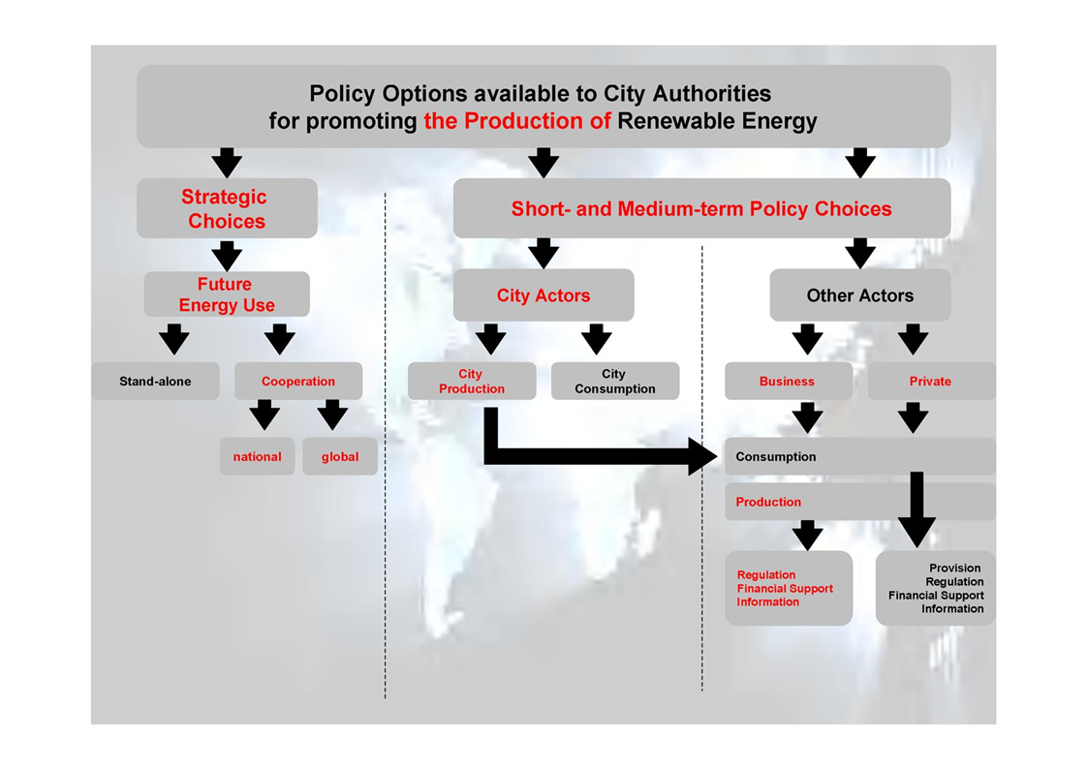
Policy Options for Cities How to promote Renewable Energy Generation

Slide 10
Urban governance and the green agenda Two trends in going green
Awareness ca,mpaigns
Green-concsious growth
Incentives for consumption
Subsidies for energy production
Regulating standards
Research & Development
Attracting investment
CDM projects
Green-driven growth

Slide 11
Entrepreneurial green cities Two trends in going green
Awareness ca,mpaigns
?
Green-concsious growth
Incentives for consumption
Subsidies for energy production
Regulating standards
Research & Development
Attracting investment
CDM projects
Green-driven growth

Slide 12
Step 3: Entrepreneurial green city Looking beyond the first experiments
Masdar, United Arab Emirates
Green-concsious growth
Cape Town, South Africa
Songdo, South Korea
Pune, India
Zira Island, Azerbaijan
Wuxi, China
Green-driven growth

Slide 13
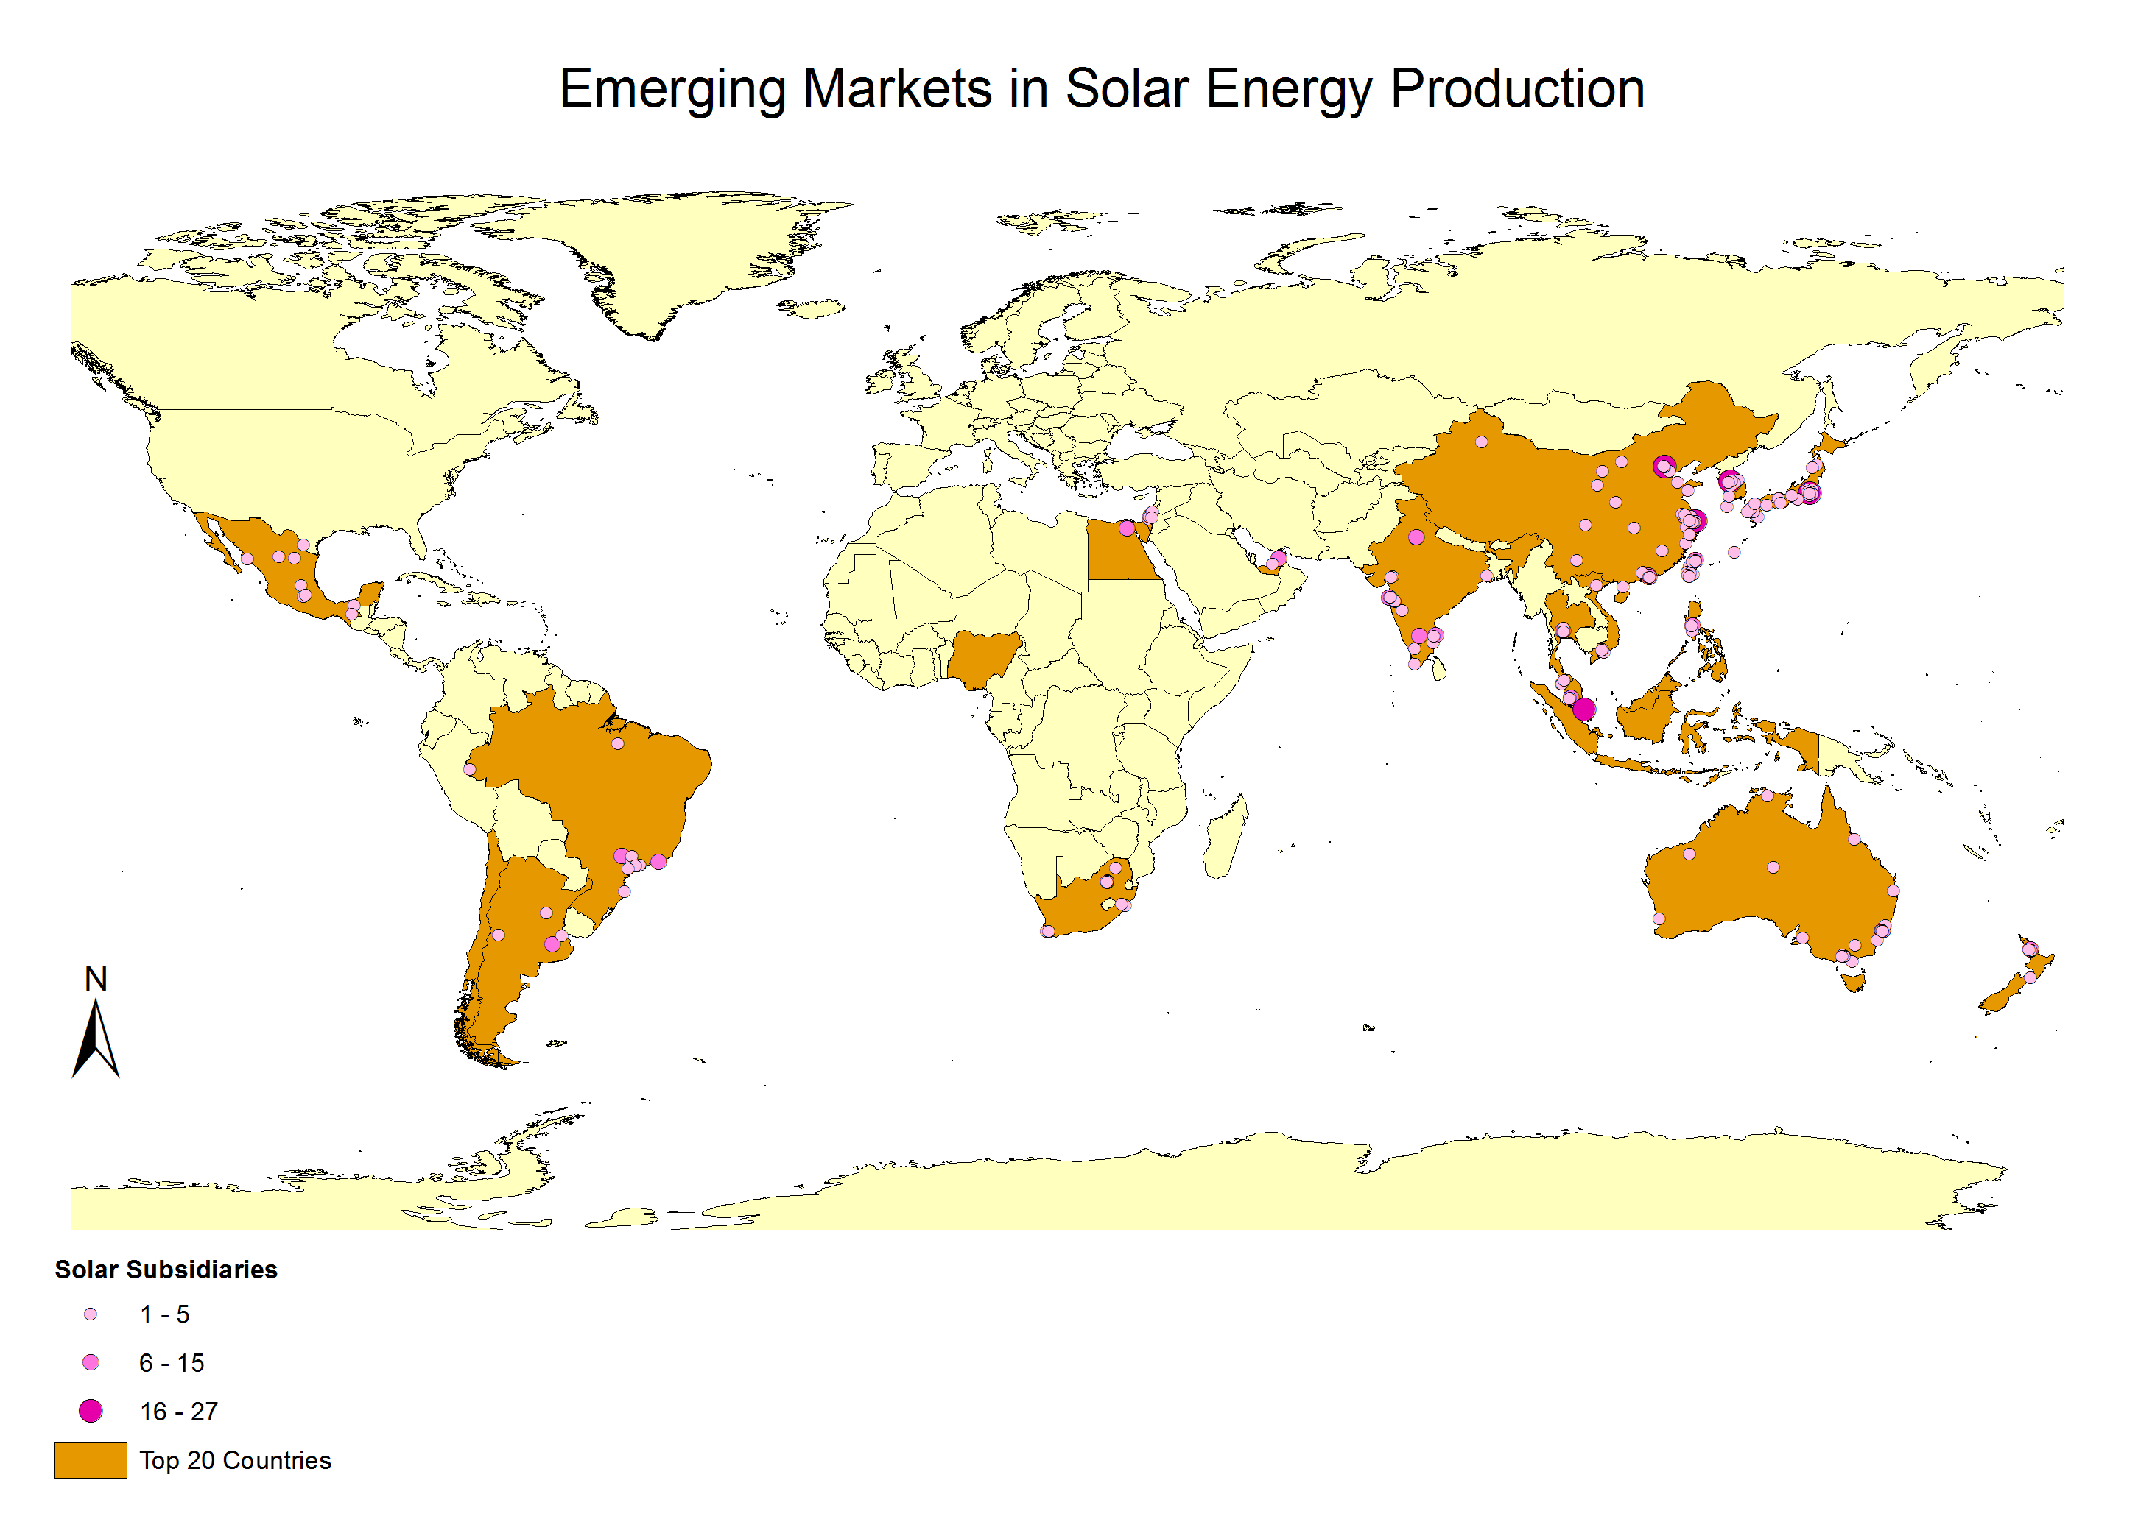
Renewable Energy Investment trends in an emerging sector - SOLAR

Slide 14
Renewable Energy Investment trends in an emerging sector - WIND

Slide 15
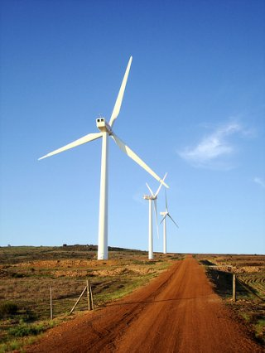
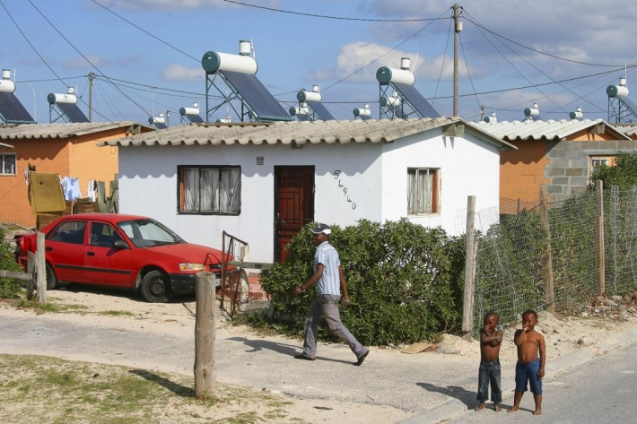
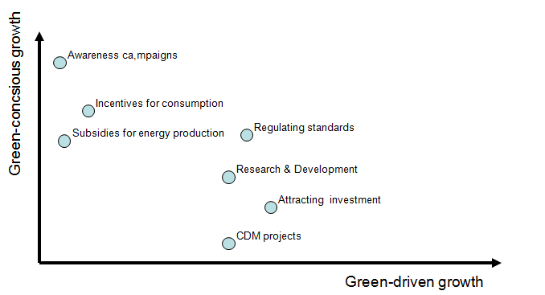
Case Study: Cape Town Dilemma’s of a pioneer
Early action: 2002 WSSD
Commitment on municipal level
Key figures advocating pilot projects
First results in 2008
Assessing the problems
But now: waiting for national regulation

Slide 16
Way Forward Research Questions
Which medium-size cities are emerging centres of the global renewabble energy sector?
To what extent to they combine GCG with GDG?
Which strategies do municipalities follow …?
What challenges do municipalities face…?
How much autonomy do these municipalities have…?

Slide 17
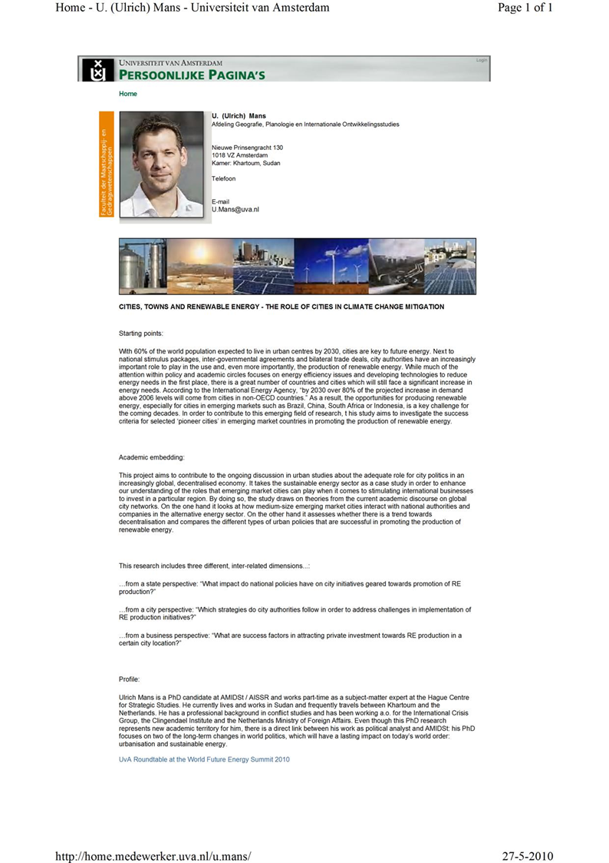
Thank you.
u.mans@uva.nl
http://home.medewerker.uva.nl/u.mans/

Slide 18
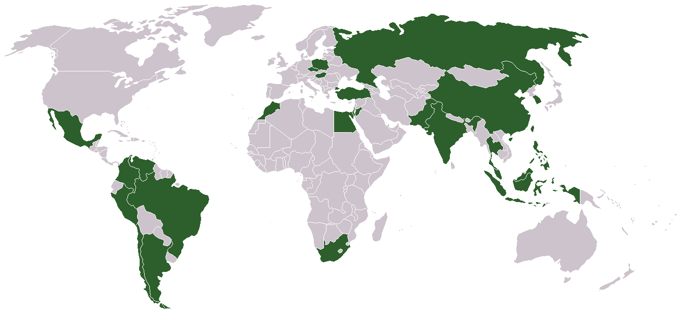
Looking at the world’s periphery Why emerging markets matter
Large share of world population
High economic growth
Demographic growth
High levels of urbanisation
Living standards rise
Result: Energy demand increases in emerging markets

